Slide 1
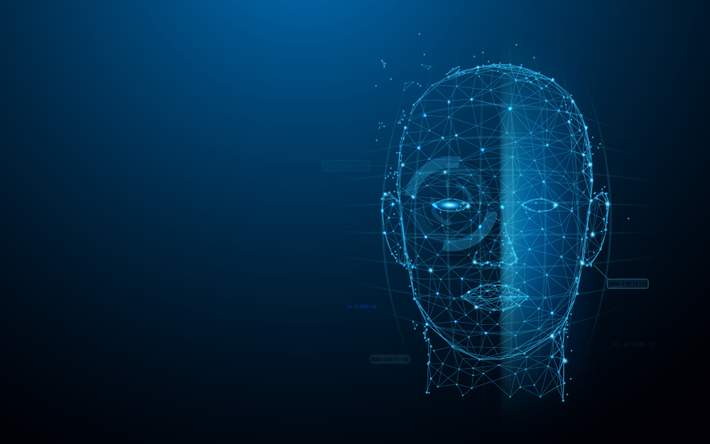
Human Face Recognition Attendance System
Group Name: Exception
Group Member:
Farhat Tasnim – 1410482042 - farhat.tasnim@northsouth.edu
K.M.H.Mubin -1621802042 – kmh.mubin@northsouth.edu

Slide 2
IntroDuction
As we are making a system which can recognize face and match with its own database. It will make the attendance system more authentic. Our primary goal is to help the lecturers, improve and organize the process of track and manage student attendance and absenteeism.

Slide 3
What Is Face Detection?
Face detection is a type of computer vision technology that is able to identify people’s faces within digital images. This is very easy for humans, but computers need precise instructions. The images might contain many objects that aren’t human faces, like buildings, cars, animals, and so on.

Slide 4
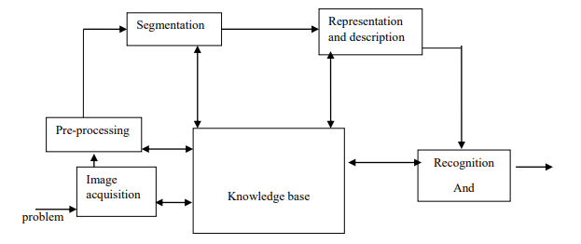
Plan of works

Slide 5
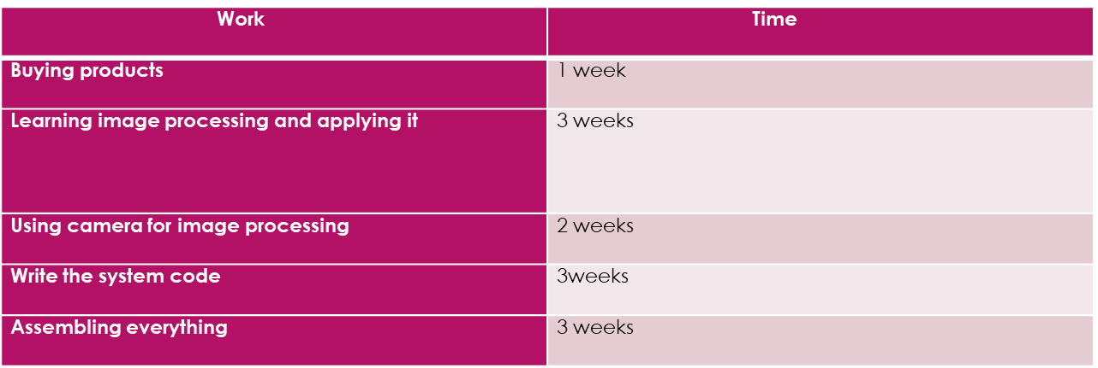
Time Frame

Slide 6
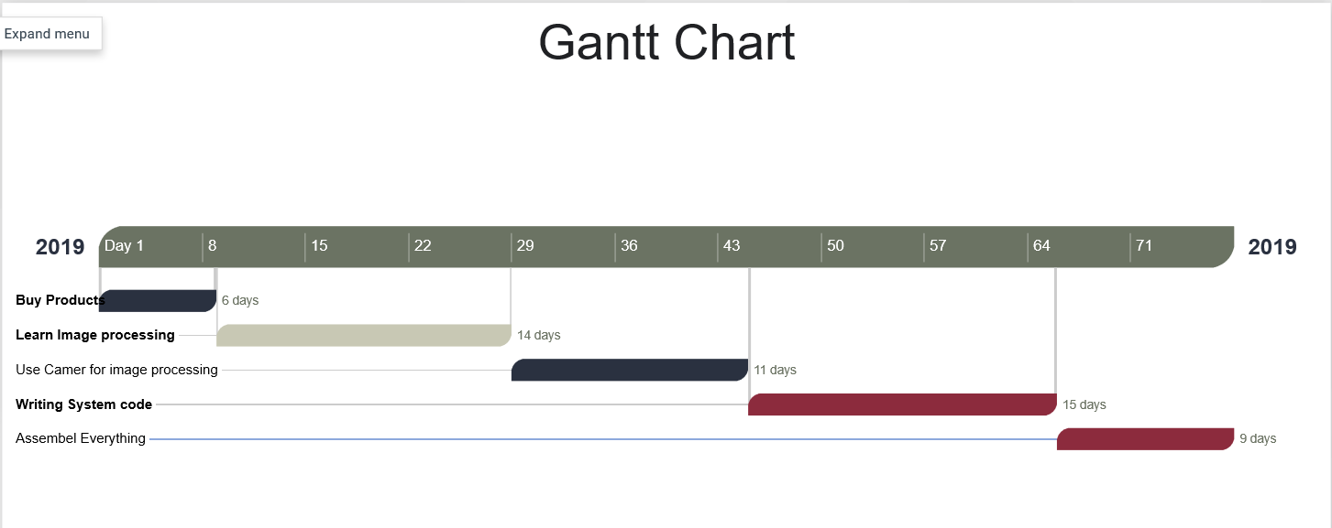
Gantt Chart

Slide 7
Specifications of the product
Product name | Prices
HD webcam | 1000
Raspberry pi | 4000
SD card | 500
Total | 5500

Slide 8
Software Used
Program language: Python 3
Software:
1. pycharm

Slide 9
Advantages
The system stores the faces that are detected and automatically marks attendance.
Ease of use is manipulate and recognize the faces in real time using. Multiple face detection. Multipurpose software Can be used in different places.

Slide 10
DisAdvantages
The accuracy of the system is not 100%. It can only detect face from a limited distance.

Slide 11
What Are Features?
A feature is a piece of information in an image that is relevant to solving a certain problem. It could be something as simple as a single pixel value, or more complex like edges, corners, and shapes. You can combine multiple simple features into a complex feature.
Applying certain operations to an image produces information that could be considered features as well. Computer vision and image processing have a large collection of useful features and feature extracting operations.
Basically, any inherent or derived property of an image could be used as a feature to solve tasks.

Slide 12
Result Analysis
In our project we have been working more the 1200 pictures. Our result of our project percentages is almost 80-81%. Thou it is not enough for this little dataset. To make almost 98% accuracy we need to use more powerful hardware and also need more resources.

Slide 13
Why we don’t use Neural Network.
Raspberry Pi isn’t powerful enough to compute the images using neural or deep learning.
The problem are:
not enough ram
Processor is slow
not the right hardware for heavy computational processes

Slide 14
Future works
In future, we are going to make our project online. So that this project can be use in bigger area like University, work place , factory etc. And also add the neural network or deep learning. If we use the neural network we can have more accuracy around 99.9% with big datasets.

Slide 15
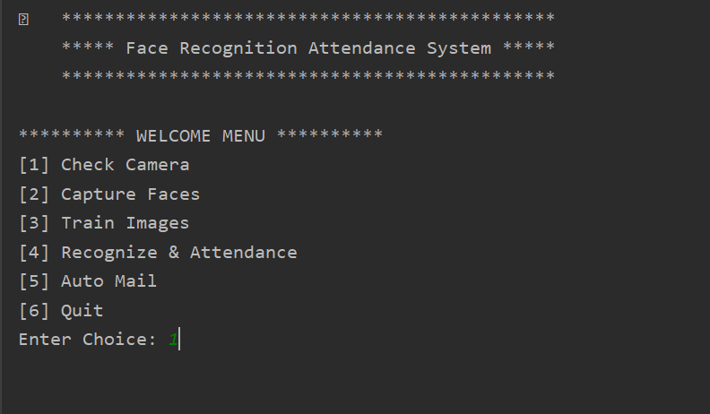
FRAS Interface

Slide 16
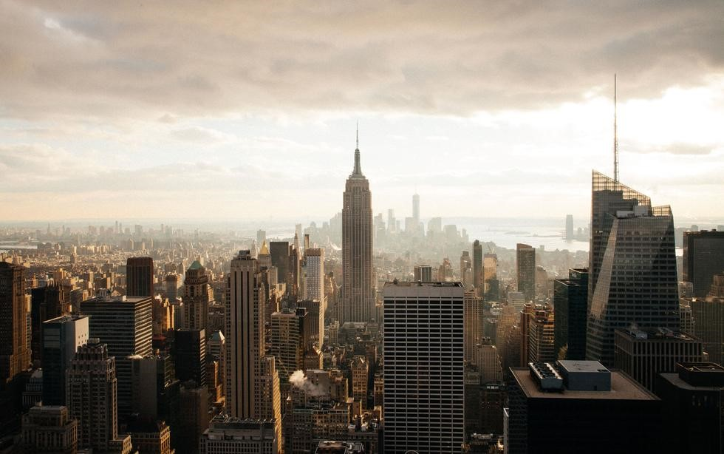






Milestone & TIME FRAME
100%
100%
100%
100%
100%
E
Buying
Products
Image Processing
& apply
Write System
code
Use camera for Image
Processing
Assembling Everything

